Slide 1

MIMIC ML/DL (Sleep Apnea)

Slide 2
Github (Code)
Code Here
https://github.com/CountDer3k/Homework-AIH-2025/tree/main/HW5
Make Sure to read Speaker Notes

Slide 3
Learning Objective
MIMIC-IV
ML/DL Techniques
Evaluate Results
Use the MIMIC-IV dataset
Collect data on patients with sleep apnea
Create a balance dataset with patients with and without ‘sleep apnea’
Use a regression algorithm to predict the probability of a patient having ‘sleep apnea’
Use RandomForest for best regression model
Plot results model prediction
Fine-tune model
Evaluate most important features for prediction

Slide 4
Data Collection from MIMIC-IV

Slide 5

1 - Data Collection
This applies to the ‘1 - Data Collection’ notebook
Preload all data (01)
Patients with ‘sleep apnea’ (02)
The 1st block preloads all data.
A function to calculate age defined.
ICD9 code established.
Age column added.
All tables combined.
Columns cleaned & data dropped
Comparison set (03)
Condense & Save (04)
New dataset with random equal amount of patients without ‘sleep apnea’.
Combine both datasets into one.
Max of 500 entries are sample per patient.
Save data to csv file.
Notes:
For data collection I will give an overview and the following slides will provide the code used.
01)
All that is preloaded by importing libraries.
Age is calculated by subtracting any existing date of death and date of birth
ICD9 code is 32723
02)
We start by adding an age column for each entry, and make sure to remove any out of place or outlier ages
We combine the patients with admissions and labevents which is already combined with labitmes.
This is done to have plenty of information to look into for each patient
Lastly for this section we drop any column we are not planning on using and drop any empty rows and then we can filter out the patients with the ICD9 code
03)
To balance the dataset for training, we will not get an equal amount of unique patients who do not have sleep apnea
Now the two datasets are combined into a single one which we will use during training
04)
The dataset had over 6 million entries and training on hardware was reaching limits.
The dataset therefore was reduced to have at most 500 entries per patient, reducing the entries to just under 300,000 (plenty for a valid dataset)
The dataframe is then saved to a csv file which will be used during training

Slide 6
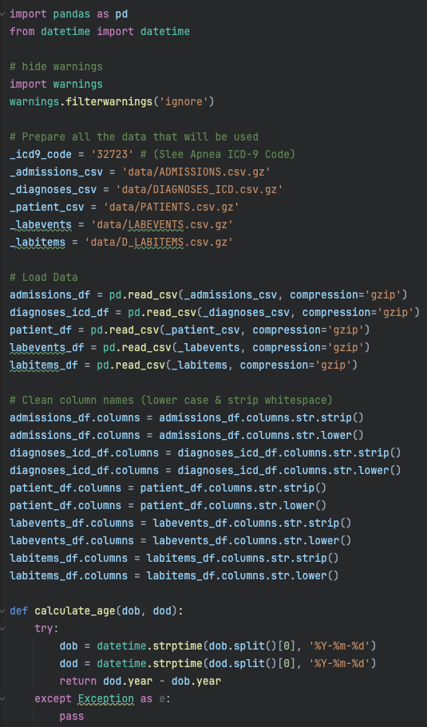
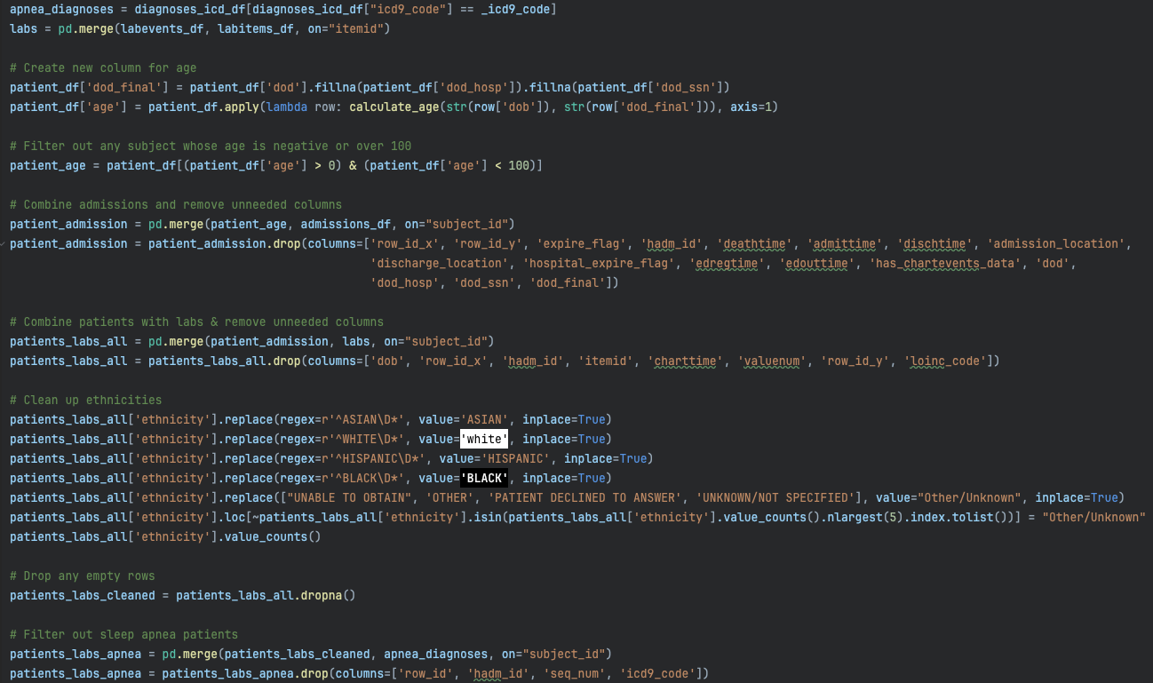
1 - Data Collection (Code)
Preload all data (01)
Patients with ‘sleep apnea’ (02)

Slide 7
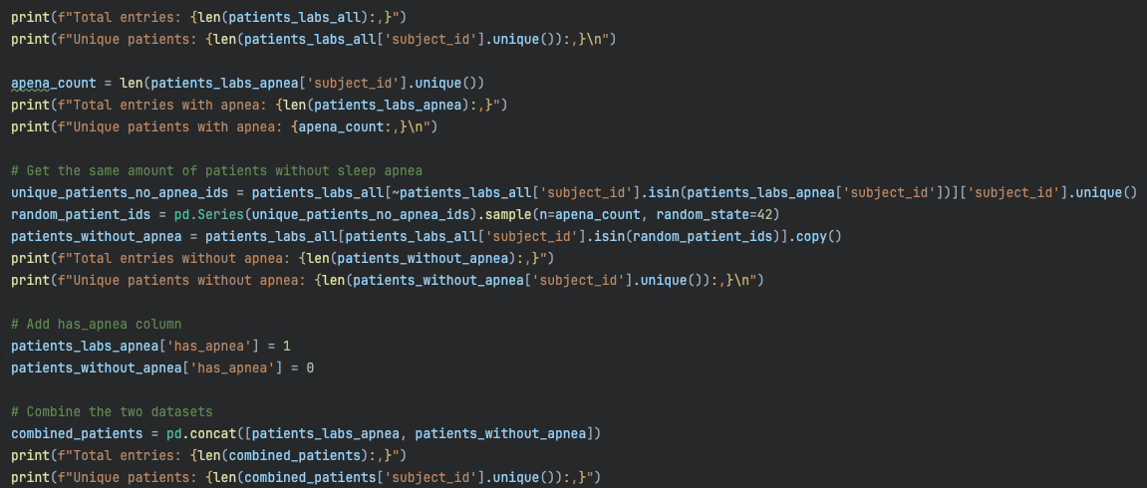
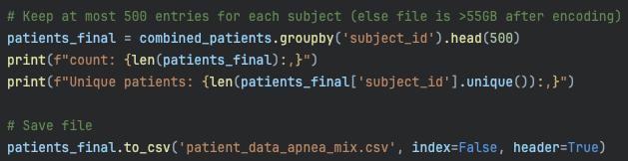
1 - Data Collection (Code)
Comparison set (03)
Condense & Save (04)

Slide 8
Random Forest Classifier Model

Slide 9
2 - Regression Model
This applies to the ‘2 - Regression Model’ notebook
Prepare data (01)
Train Model (02)
Data Loaded
Data Split for training/testing
Use RandomForestClassifier
Train model
Make Predictions & Probabilities
Feature Importance (03)
Plots (04)
Calculate the top features the model focused on.
Plot all predictions, probabilities, and relevant data for analysis.
Notes:
For data collection I will give an overview and the following slides will provide the code used.
01)
We begin by loading the data from the csv
We have an option to drop the ‘diagnosis’ column in the case we believe it may be skewing the training
The data is then split into training and testing
02)
Training the model runs the random forest classifier “fit()” function and calculates the accuracy and predictions the model makes.
03)
This function will calculate the importance of the features used by the model and allow us to analyze them.
04)
The remaining functions are used to generate plots depending on the data we’ll be analyzing.

Slide 10
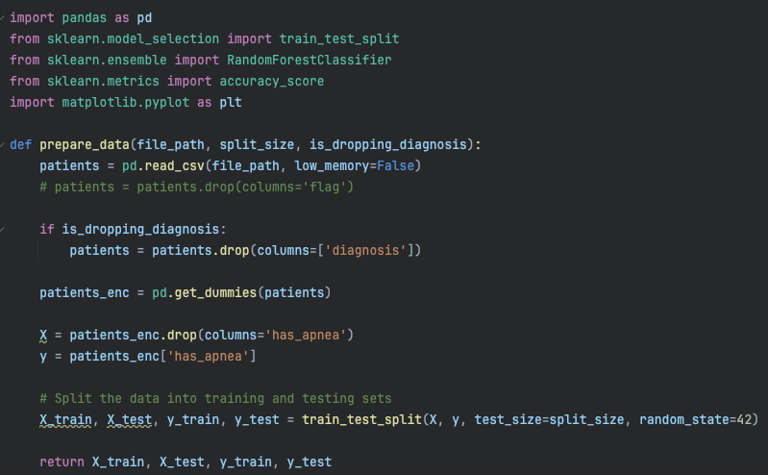
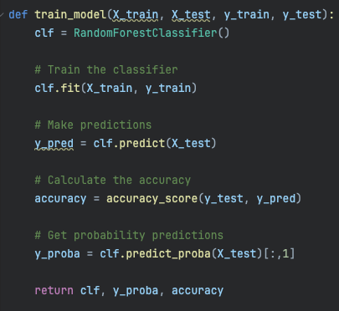
2 - Regression Model (Code)
Prepare data (01)
Train Model (02)

Slide 11
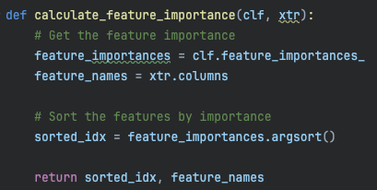
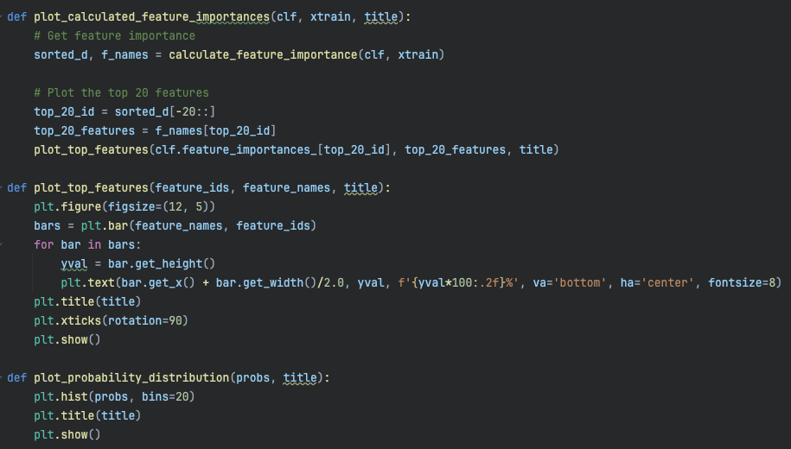
2 - Regression Model (Code)
Feature Importance (03)
Plots (04)

Slide 12
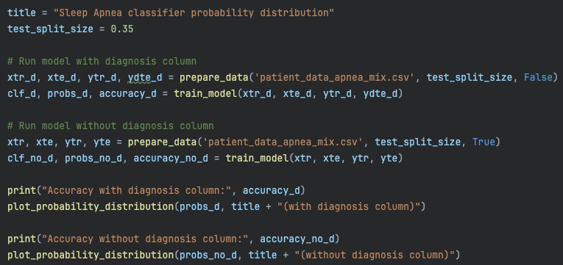
2 - Regression Model (Code)
Running the Model
Notes:
This is the code that will run the model and output the graphs shown prior.
The dataset here was set to 35% of the dataset will be reserved for testing.
We also ran the model twice: The first runs with the ‘diagnosis’ column while the second removes that column in case that columns sways the results significantly.

Slide 13
Evaluation

Slide 14
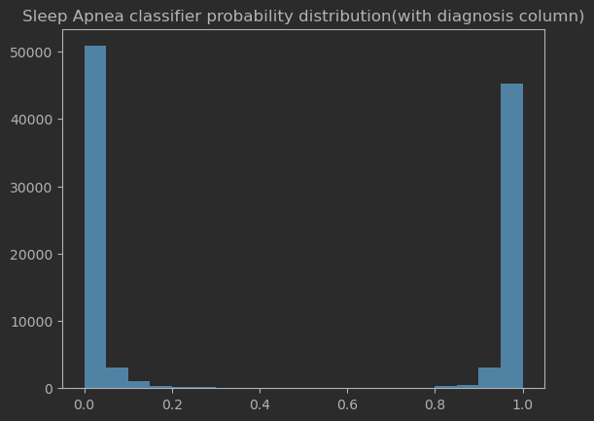
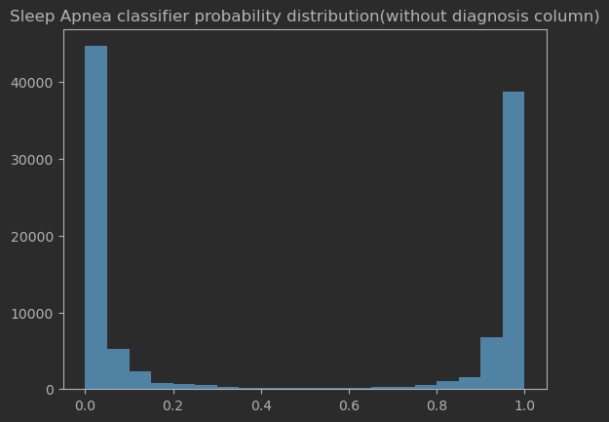
Model Accuracies
Here we have both models’ probability distribution plots.
Overfitting?
Accuracy: 99.98%
Accuracy: 99.48%
Notes:
The model shows high accuracy with >99% both with and without the ‘diagnosis’ column.
This could indicate overfitting for our model. We’ll dedicate the following slides to see if there is overfitting and we’ll fine tune the model accordingly.

Slide 15
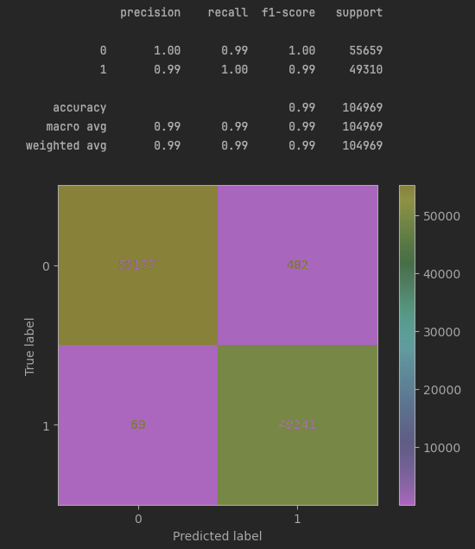
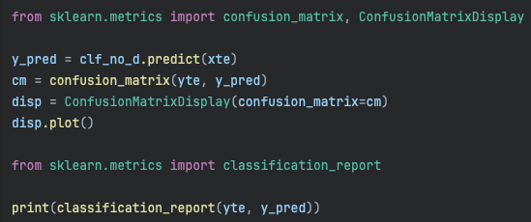
Model Accuracy Analysis
Confusion Matrix Classification report
Not overfitting…?
Notes:
To check if the model is overfitting, we will run the following code to generate a confusion matrix and a classification report.
By checking the confusion matrix, the model is very good at correctly predicting both True Negative and True Positive. This means the model is not just guessing one thing and succeeding because of “lucky” guess. It appears to be classifying correctly.
The classification report shows the F1-score being very high meaning there isn’t an imbalance in the classes (range of having sleep apnea)

Slide 16
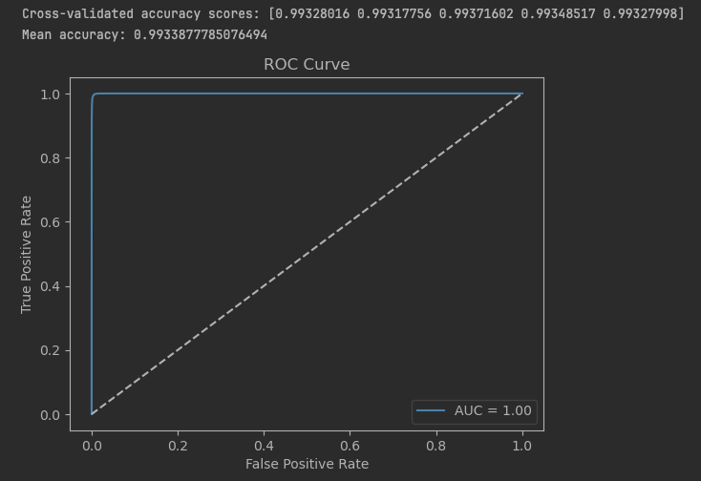
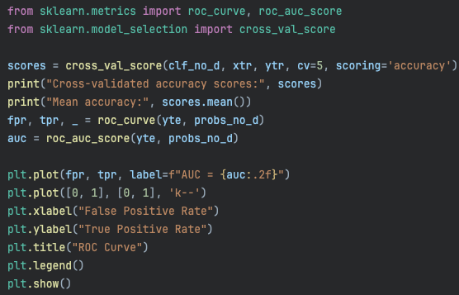
Model Accuracy Analysis
ROC Curve
Cross-Validation
Not Overfitting.
Notes:
As a final test to check for overfitting even though now it appears that the model is not overfitting, we will now check ROC curve and run a cross-validation on our model to check for any inaccuracies.
The ROC curve being so close to the top left corner indicates the model has really good separation between the 2 classes (to have or not have sleep apnea)
The cross-validation results also show consistent high accuracy.
The model is not overfitting.
Our model can accurately predict if a patient has sleep apnea.
So now we can further analyze what the model is looking at for its predictions.

Slide 17
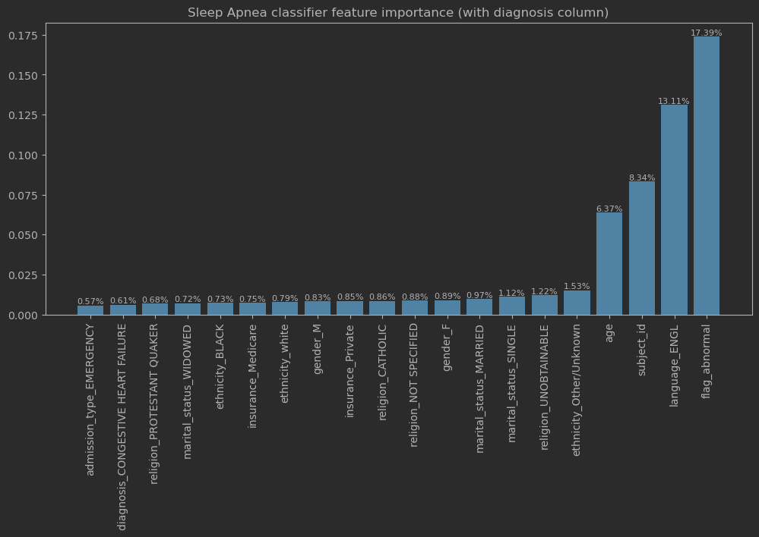
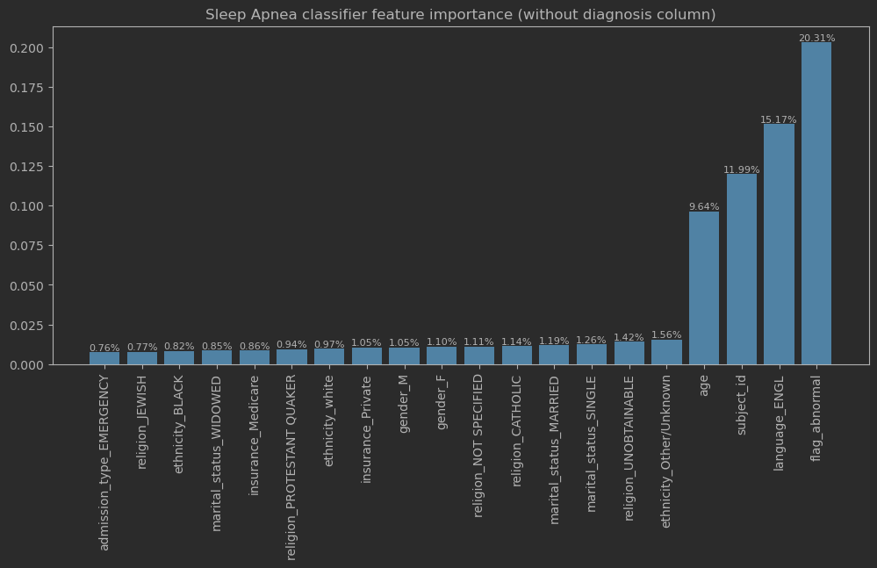
Model Accuracy Analysis
Feature Importance
Possible overfitting on subject_id
Notes:
Now that we have high accuracy, we want to look into what the model is observing to achieve such high accuracy.
Though most looks good, there is one possible discrepancy.
The subject_id is in the top 3 features for prediction.
This could mean that it will check if the model subject is not a ‘sleep apnea’ subject id, it may significantly drop the possibility of that patient having sleep apnea. Since we have multiple entries from labevents for each subject, the model could be learning what patients have sleep apnea and not actually looking at the rest of the information for its prediction.
This is effectively “cheating” by just looking at the person and already knowing they have sleep apnea due to them being in the training.
This will have to be trained again without subject id to verify the model’s true strength.

Slide 18
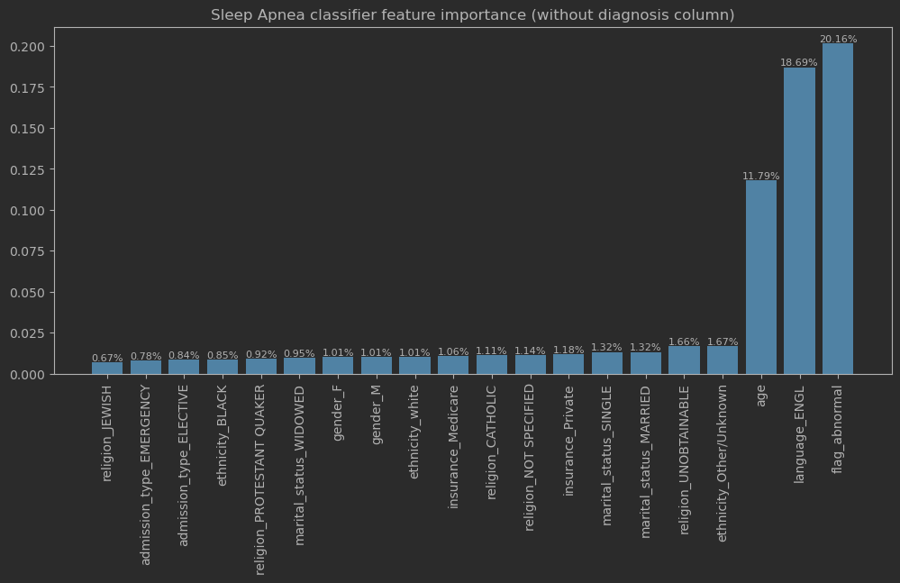
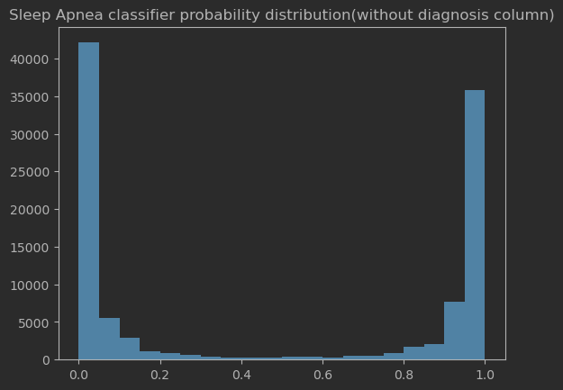
Model Accuracies (refined)
Trained again without ‘subject_id’ column
Still have high accuracy
Accuracy: 98.47%
Notes:
Once we re-trained without subject_id our accuracy dropped by about 1%
This means the model is still high in its predictive ability and the subject_id though a strong indicator is not all the model needed to properly classify patients.

Slide 19
Key Findings
20.16%
18.69%
11.79%
Flag_Abnormal
Language_ENGL
Age
Notes:
From the top 20 features, only 3 features really stand out above 2%.
These are the 3 highest feature indicators for a patient having sleep apnea. They account for 50.64% of feature importances.
These results make sense for the abnormal flag. If a patient does a lab test and something is abnormal it would make sense for that to be an indicator of a disease or physical abnormality.
Language is not clear, and age will need deeper dives to understand what age groups could be more affected.

Slide 20

Summary
Model Performance
Features of importance
The model has very effective performance and can give with high confidence the probability of a patient having ‘sleep apnea’ based on lab event history
The most important factors to be diagnosed with sleep apnea:
Abnormal lab results
Spoken language
Age
Disclaimers
Future Work
The information here has DOB & DOD altered to protect identities.
Age many not be a true factor in a non-modified dataset
More work can be done in age to further help clinicians quickly diagnose patients with sleep apnea based on age
Use larger dataset for more complete feature analysis.

